Slide 1
Fault Tolerance
Reliable System from Unreliable Components

Slide 2
War stories: MAXC & Alto
MAXC: time-sharing computer system
  Intel 1103: 1024-bit memory
  FT: Single-error-correction, double-error-detection
    Extra bits for each 36-bit
  Result: solidly reliable, no errors were reported
Alto: personal workstation
  The same Intel memory chip
  FT: Error-detection only
    One parity bit for each 16-bit
  Result: report frequent mem-parity failures months later
    (Bit-map display Bravo) + (pattern-sensitive 1103)

Slide 3
War stories: MAXC & Alto
Lesson-1:
  There is no such thing as a small change in a large system
  A new software can bring down hardware that is thought to be working perfectly
  You are never quite sure just how close to the edge of the cliff you are standing
Lesson-2:
  Experience is a primary source of information about failures
  It is nearly impossible, without specific prior experience, to predict what kinds of failures you will encounter in the field

Slide 4
War stories: MAXC & Alto - cont.
Back to MAXC
  Hardware reports both corrected errors and uncorrectable errors
  But software only logged uncorrectable errors
    Ignored corrected errors, which were occasional
Lesson
  Safety margin principle is important when system implement automatic error masking
  Otherwise, despite the attempt to put some guaranteed space between yourself and the cliff, you may be standing on the edge again

Slide 5
War stories: MAXC & Alto - cont.
Alto-2 with new memory chip with 4096 bits
  Single-error-correction, double-error-detection
    Again, flawlessly
  Two years later, an implementation mistake is discovered
    Neither error correction nor detection was working on 1/4 cards
Lessons
  Never assume the h/w does as it says in the spec
  It is harder than it looks to test the FT features of a FT sys
  Just because it seems to be working doesn’t mean that it actually is

Slide 6
War stories: MAXC & Alto - cont.
Memory chip does become better
  But never perfect
  Errors often don’t lead to failures
  Bit-flip can be benign
The bottom line
  Sometimes, failure is blamed on something else
    Maybe that’s why PC manufacturers often do not provide memory parity checking hardware
    You never know it h/w error or s/w error

Slide 7
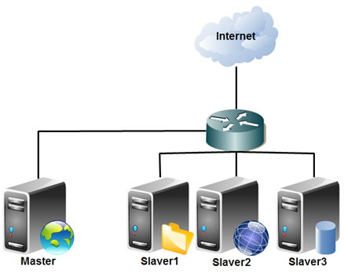

Slide 8
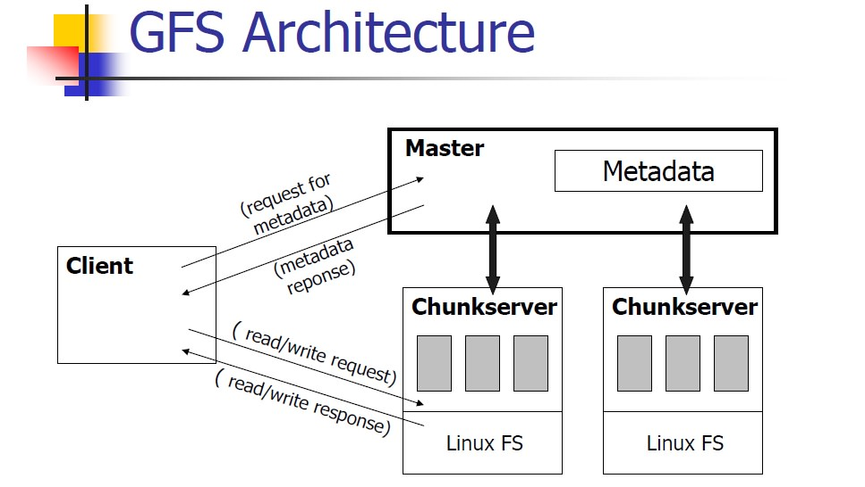


Slide 9
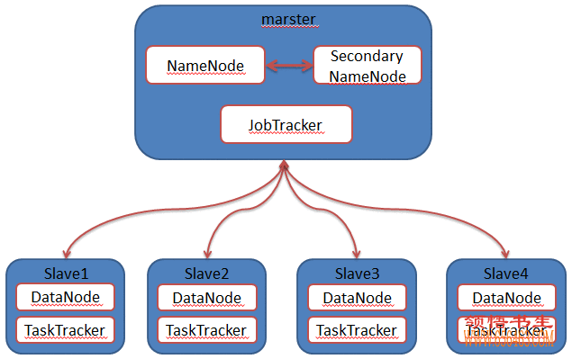
Hadoop/google file system

Slide 10
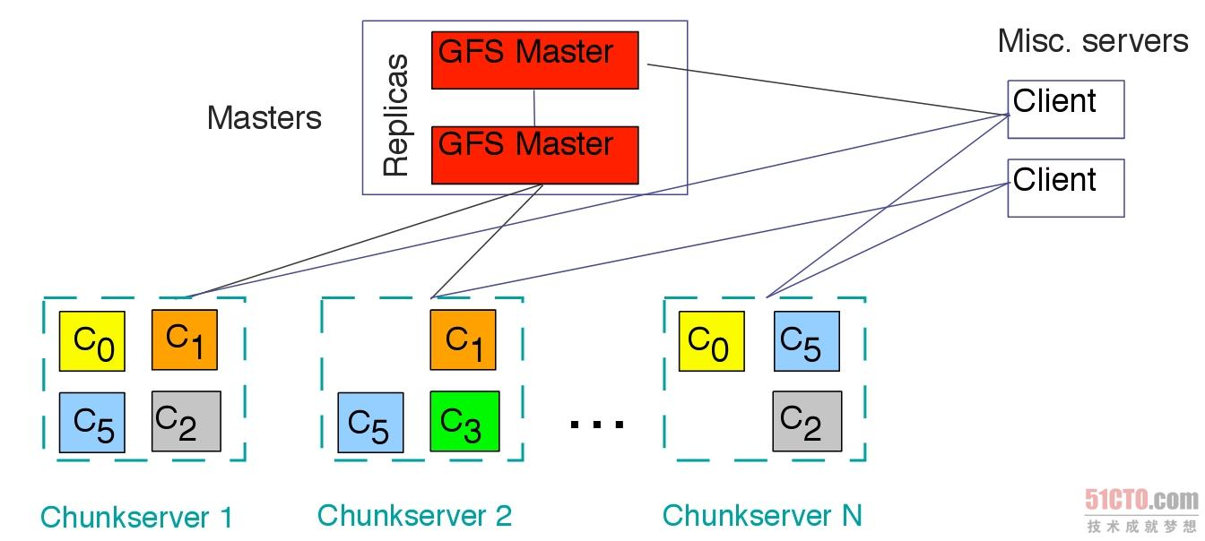

Slide 11
Three steps to building reliable systems
Error detection
  Discover error by redundancy
Error containment
  Limit error propagation by modularity
Error masking (error correction)
  Operate correctly despite the error, by providing enough redundancy

Slide 12
We’ve already known
Error containment
  Enforced modularity, as provided by client/server: architecture, virtual memory, and threads
Error detection
  Network links identify and discard damaged frames
Error masking
  Masking loss: e2e protocols time out and resend lost data
  Masking failure: routing algorithms find a way around links that fail
  Masking loss: real-time applications fill in missing data by interpolation or repetition

Slide 13
Fault
Software fault
  E.g. programming mistakes
Hardware fault
  e.g. a gate whose output is stuck at the value ZERO
Design fault
  e.g. installing too little memory in a telephone switch
Implementation fault
  e.g. installing less memory than the design called for
Operations fault
  e.g. running a weekly payroll twice last Friday
Environment fault
  e.g. lightning strikes a power line causing a voltage surge

Slide 14
Fault
Fault is latent or active
  If active, get wrong data or control signals
  These wrong results are errors
    e.g. violation of assertion or invariant of spec
  Discovery of errors is ad hoc
    Formal specifications are rare in practice
Failure:
  If an error is not detected and masked
  Not producing the intended result at an interface

Slide 15
Fault and failure
The failure of a subsystem is a fault of a system
  The fault may cause an error that leads to the failure of the larger subsystem
  Unless the larger subsystem detects the error and masks it
Example
  A flat tire -> detects the error by failure of a subsystem
  Miss an appointment -> the person notices a failure
  Change to a spare tire -> masked the error

Slide 16
Fault tolerance & error containment
Fault tolerance
  Noticing active faults and component subsystem failures and doing something helpful in response
Error containment
  Mask the error
  Fail-fast: detect and report the error
  Fail-stop: immediately stop dead
    Problem: how to tell the state of “stopped” or “being slow”?
  Fail-thud: do nothing, simply do wrong without warning

Slide 17
Fault
Transient faults
  Single-event upset
  E.g. Lightning, cosmic ray
  soft error : retrying can correct it
Persistent faults
  E.g. stuck-at-ZERO
  hard error
  Intermittent fault: active occasionally
Latency
  Between a fault causes an error and the error is detected or causes the module to fail

Slide 18
Example
Stuck-at-ZERO in a memory chip
  Persistent fault
When the bit should contain a ONE
  The fault is active and the value is in error
If a cosmic ray flips another bit
  A transient fault has caused the bit in error
error correction code
  Can mask the fault
If someone tests the module
  May not reveal a failure
  The user doesn’t realize the persistent error ( is hidden)

Slide 19
The fault-tolerance design process
Fault-avoidance
  Build entirely of components that are reliable
  Not practical, for large N ------ (1-p)^{N}
      P : probability of failing
Fault-tolerance
  1. Begin to develop a fault-tolerance model (8.3):
    Identify every potential fault
    Estimate the risk of each fault, as in Section 8.2
    Where the risk is too high, design methods to detect the resulting errors

Slide 20
The fault-tolerance design process
2. Apply modularity to contain the damage from the high-risk errors
3. Design and implement procedures that can mask the detected errors, using the tech in 8.4
  Temporal redundancy. Retry using the same components
  Spatial redundancy. Have different components do the operation
4. Update the fault-tolerance model to account for those improvements
5. Iterate the design and the model until the probability of untolerated faults is low enough that it is acceptable

Slide 21
The fault-tolerance design process
6. Observe the system in the field
  Check logs of how many errors the system is successfully masking. (Always keep track of the distance to the edge of the cliff)
  Perform postmortems on failures and identify all of the reasons for each failure
7. Use the logs of masked faults and the postmortem reports to revise and improve the FT model and reiterate the design
Deciding a risk of failure is “unacceptable high” or “probability of an untolerated fault is low enough that it is acceptable”
  Different application requirements can lead to different approaches
  Tradeoff
  e.g. PC vs. space-flight guidance

Slide 22
Safety-net Principles
be explicit
  Get all of the assumptions out on the table
Design for iteration
  Hard to estimate probabilities of failure
Safety margin principle
  Someone should monitor how often errors are masked
Keep digging
  Always look beyond the first obvious cause; mind set allow some others
Adopt sweeping simplifications
  Complexity increases the chances of mistakes
Notes:
Safety-net: be explicit
Unexpected failures represent omissions or violations of the assumptions.
Safety margin principle
Because the number of failures grew unnoticed until the fault tolerance of the design is exceeded.

Slide 23

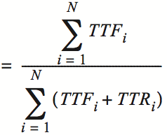
Availability and MTTF
TTF: Time to failure
TTR: Time to repair

Slide 24



MTTR & MTBF
MTBF: mean time between failure
  One can reduce down time by reducing MTTR or by increasing MTBF

Slide 25
Measuring MTTF
Two purposes
  Evaluating & predicting
Measuring MTTF, how ?
  The more reliable, the longer it takes to evaluate
  Not measure directly
  Use proxies to estimate its value
One way to measure “MTTF”
  e.g. 3.5-inch disk’s MTTF is 300,000 hours (34y)
  Guess: ran 1,000 disks for 3,000 hours and 10 failed, then invert the failure rate
  If the failure process were memoryless, then OK
  “expected operational lifetime” is only 5 years

Slide 26
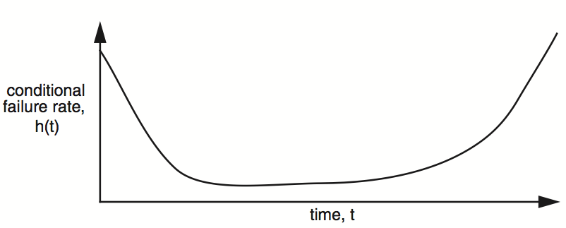
Measuring MTTF
Bathtub curve
  Infant mortality: gross manufacturing defects
  Burn out: accumulated ware and tear cause failure
  Burn in: run for a while before shipping

Slide 27
Learning curve
Learning curve
  The first components coming out of a new production line tend to have more failures
  Result of design of iteration
Satellite VS. ground-based storage system
  34 years is meaningful only if replacing is easy
Accelerated aging
  Amplifying the cause that dominants
  e.g. store CD at various temperatures for months

Slide 28
Availability
Counting the number of nines
  E.g. 99.9% has 3-nines availability
  Often used in marketing
Corresponding down time
  E.g. 3-nines -> 8 hour/year
  E.g. 5-nines -> 5 min/year
  E.g. 7-nines -> 3 sec/year
  Without any information about MTTF
More fine-grained
  Fail-soft, as in 8.3

Slide 29

Reliability functions
h(t): conditional failure rate, e.g. bathtub curve
The reliability, R, of a module is defined as:
f(t): unconditional failure rate

Slide 30



Reliability functions
Once f(t) is at hand, one can calculate MTTF:
Memoryless reliability function
The expected value of the inverse is not equal to the inverse of the expected value
  They are equal only in memoryless distribution

Slide 31
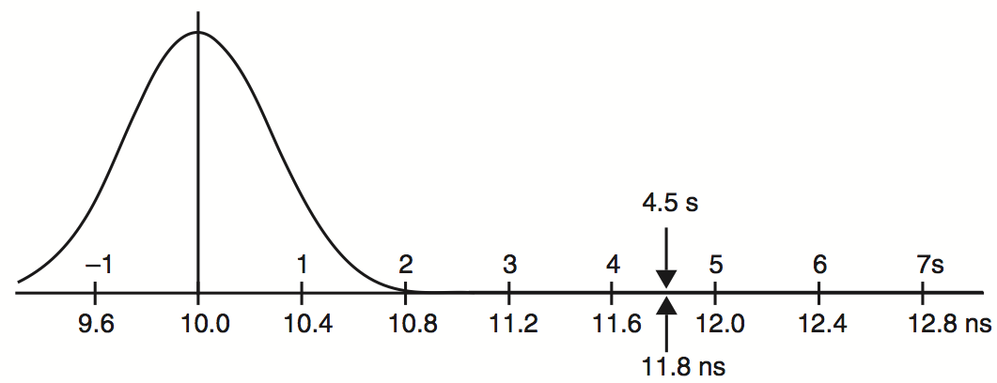
Standard deviation representation
Propagation time of gates
Ensure 4.5 σ reliability
1.8 nanoseconds is the tolerance

Slide 32
Measuring fault tolerance
Failure tolerance （k-fault tolerance system）
  The number of failures of its components ----------------that a system can tolerate without itself failing
  e.g. a memory system with single-error correction has a failure tolerance of one bit
Remaining failure tolerance
  Monitoring is important (safety margin)
List more details
  E.g. power company tolerates the failure of up to 15% of its generating capacity, as the downing of up to 2 of its lines

